Slide 1
I have the Need…. The need for speed!!!!!!!
SPEEds and Feeds

Slide 2

Proper Speeds and Feeds will alleviate most problems occurring with poor finish and cutter wear.

Slide 3

But Mr. B. Where do I find the equation or the sfpms?
Machining Section
Speeds and Feeds tables
Lathe or Mill

Slide 4
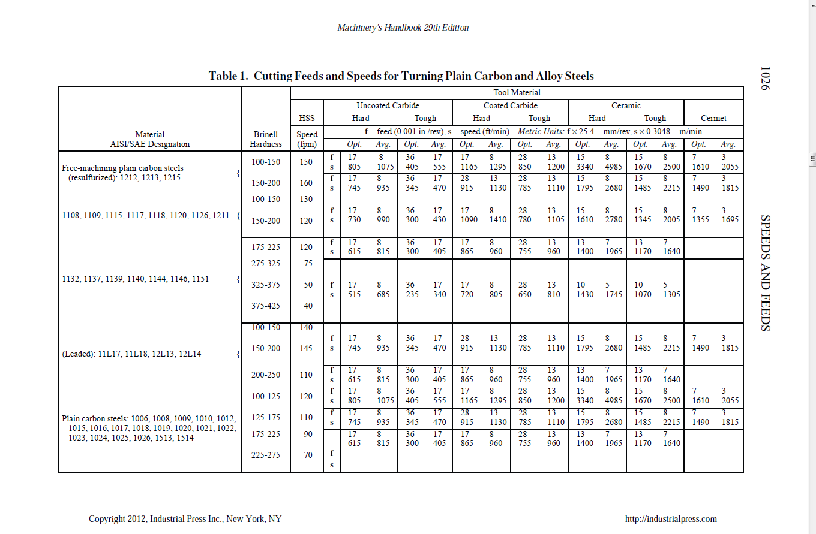

Slide 5
2nd
3rd
1st

